Slide 1
龙净CV项目第二次汇报
汇报人：朱占宸
日期：2021.8.8

Slide 2
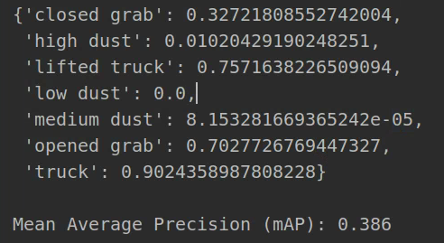
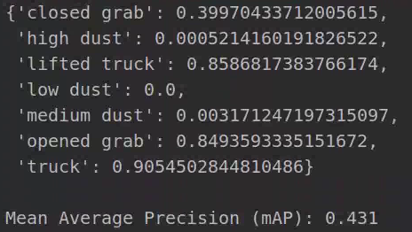
Train_data
Test_data

Slide 3
 |  | Accuracy
 |  | Train_data | Test_data
1 | lifted truck | 0.757 | 0.858
2 | tuck | 0.902 | 0.905
3 | opened grab | 0.702 | 0.849
4 | closed grab | 0.327 | 0.399
5 | low dust | 0 | 0
6 | medium dust | 0 | 0.003
7 | high dust | 0.01 | 0.0005
Train_data:12035
Test_data:3009
Iteration:10

Slide 4
 |  | Accuracy
 |  | Train_data | Test_data
1 | lifted truck | 0.757 | 0.858
2 | tuck | 0.902 | 0.905
3 | opened grab | 0.702 | 0.849
4 | closed grab | 0.327 | 0.399
5 | low dust | 0 | 0
6 | medium dust | 0 | 0.003
7 | high dust | 0.01 | 0.0005
Data size
lifted truck | 717
tuck | 13821
opened grab | 1432
closed grab | 350
low dust | 13
medium dust | 23
high dust | 52

Slide 5
感谢聆听！

